Slide 1
HMM Day 2: Diving into messy data
Ron Togunov, Marie Auger-Méthé

Slide 2
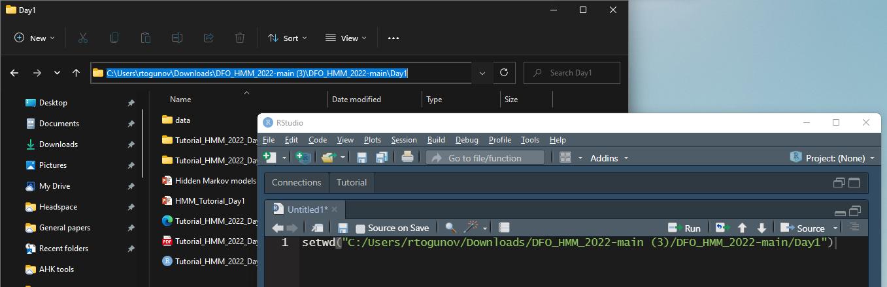
Tutorial setup
Open R and set the working directory to the “Day2” folder

Slide 3
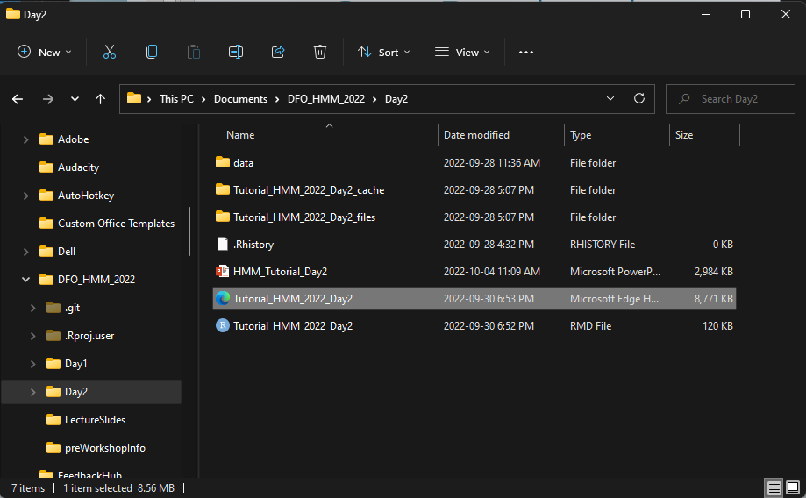
Tutorial setup
Open R and set the working directory to the “Day2” folder
Follow along with the Day 2 HTML tutorial

Slide 4
Day 2 Objectives:
Working with multiple individuals
Selecting temporal resolution
Handling missing data
Small gaps to large gaps
Linear, CRW, voiding, segmentation, multiple imputation
Integrating dive data into HMMs
Incorporating covariates on emission probabilities
Bonus: multiple imputation for error-prone data (e.g., ARGOS)

Slide 5
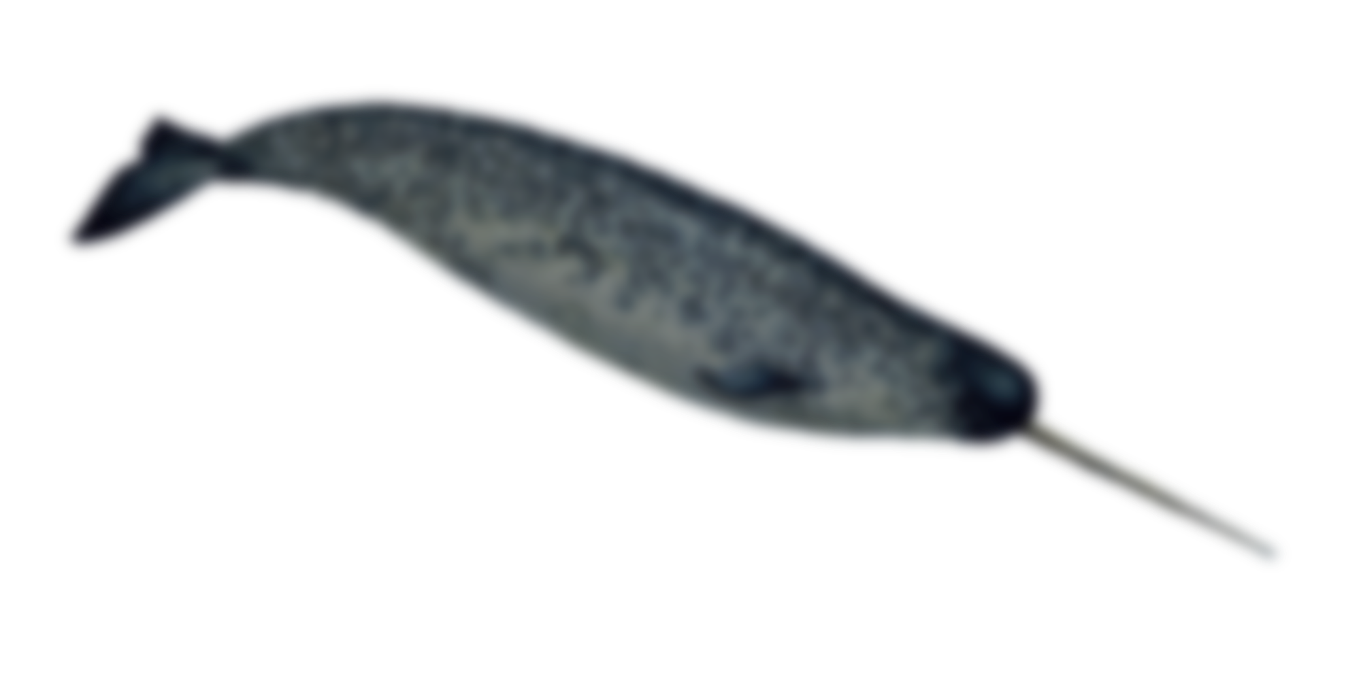
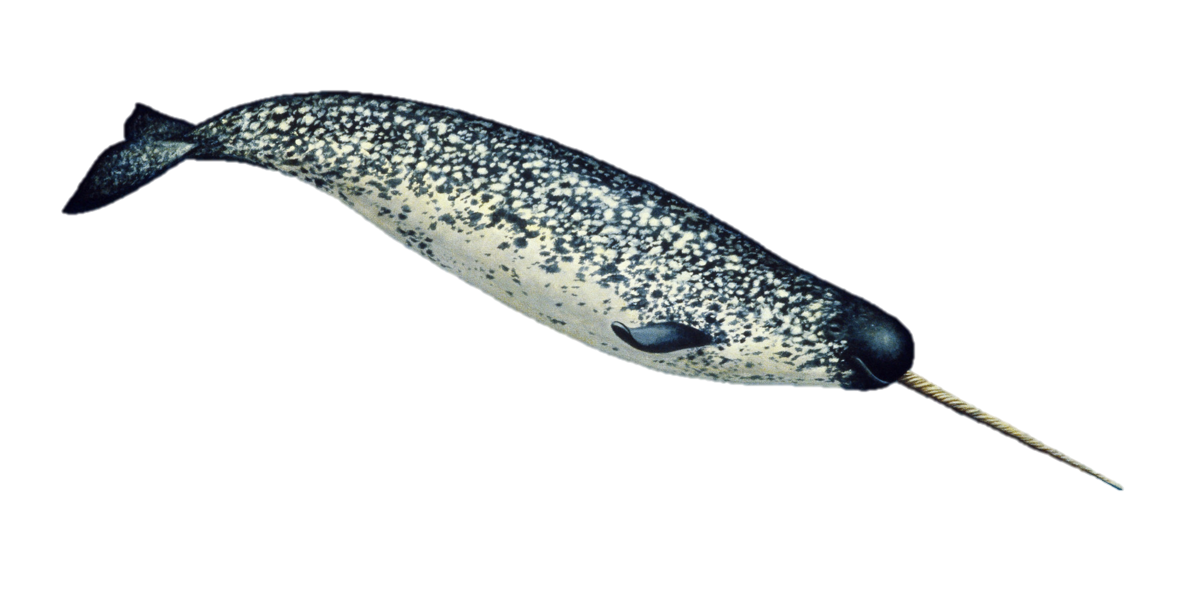
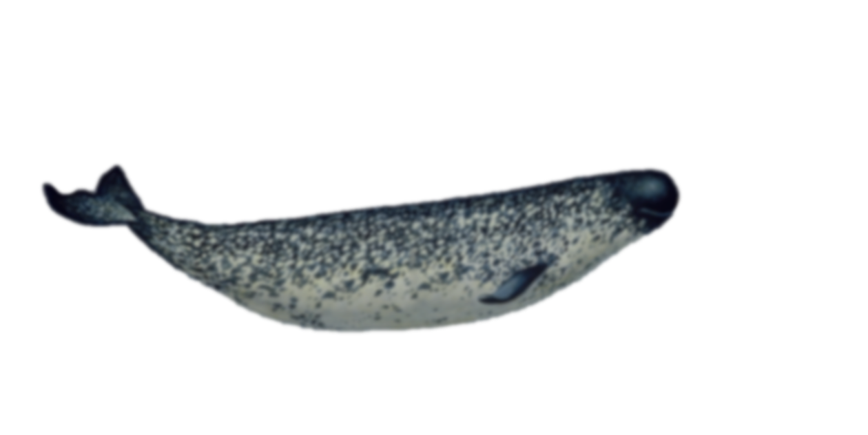
1. Narwhal data
Three Narwhals tagged in Tremblay Sound
Fastloc GPS and ARGOS location data
Mean depth data
Temporal resolution:
Fastloc GPS: 10 min
ARGOS: irregular
Depth data: 75 s

Slide 6
Working with multiple individuals
Provide statistical information and biological relevance
Requires special strategies when coding
group_by(ID) %>% summarise(…)
ifelse(ID == lead(ID), …, NA)
tracks_list <- split(tracks_df, tracks_df$ID)
lapply(list, FUN)
mapply(FUN, list_1, list_2, SIMPLIFY = F)

Slide 7
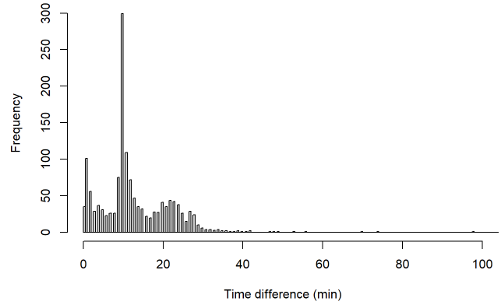
2. Selecting temporal resolution
Depends on data and study question
higher resolution isn’t always best
Visual assessment
Calculating proportion of missing data
Custom function p_na()
Data

Slide 8
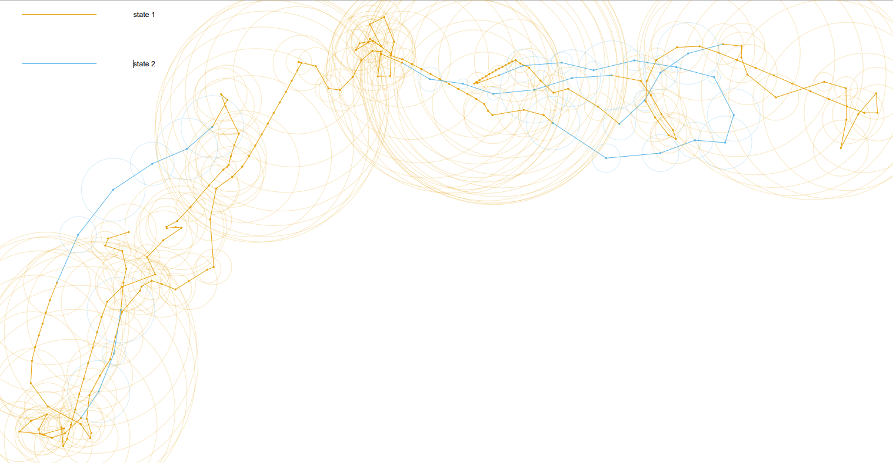
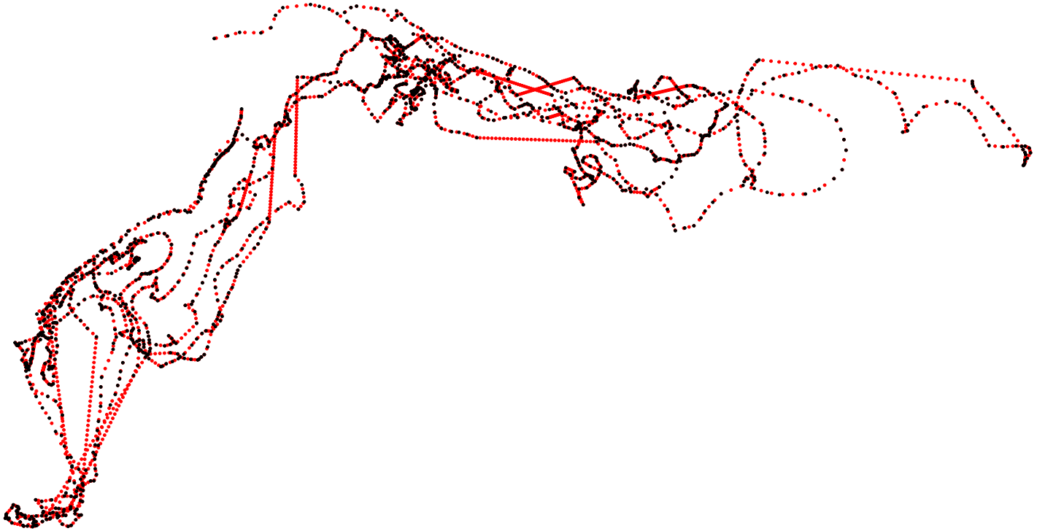
3. Handling missing data
Interpolation
Linear interpolation
approx()
Statistical interpolation
crawlWrap()
Multiple imputation
crawlWrap()
Voiding data gaps
prepData_NAGaps()
Path segmentation
New ID when gaps > threshold implemented with dplyr
group

Slide 9
Multiple imputation
When location data are temporally-irregular or subject to measurement error
Fit a CTCRW to the tracks
Can accommodate location error
Simulate temporally-regular realizations of the crawl model
Fit HMM to each simulation
Pool inferences across the HMMs
Step 1: crawlWrap Steps 2 & 3: MIfitHMM Step 4: Mipool
group

Slide 10
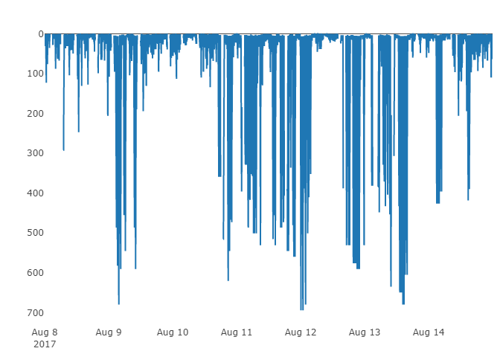
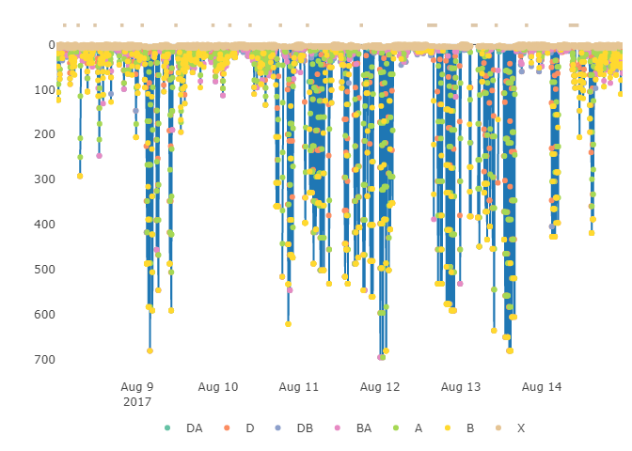
4. Integrating dive data
Calculate dive metrics using diveMove package:
Create TDR class
createTDR
Calibrate TDR data
calibrateDepth
Calculate dive statistics
diveStats
Combine data streams with different resolutions
Summarise dive stats using dplyr::summarise
group

Slide 11
4. Integrating dive data – Cont.
Selecting data streams
Minimal missing data
Evidence of multi-modality
Some autocorrelation
Minimal co-linearity
Build increasingly complex HMM
Fit simple models to each data stream separately
Get starting parameters from simpler models using getPar
Fit with fitHMM
group

Slide 12
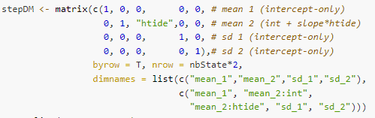
5. Covs on emission probability
Step length ~ tidal speed
Earthtide::calc_earthtide()
Effect on all states
DM = list(step=list(mean= ~htide, sd= ~1)
Effect on some states
DM = list(step=list(mean= ~state2(htide), sd= ~1)
Pseudo design matrix
group

Slide 13
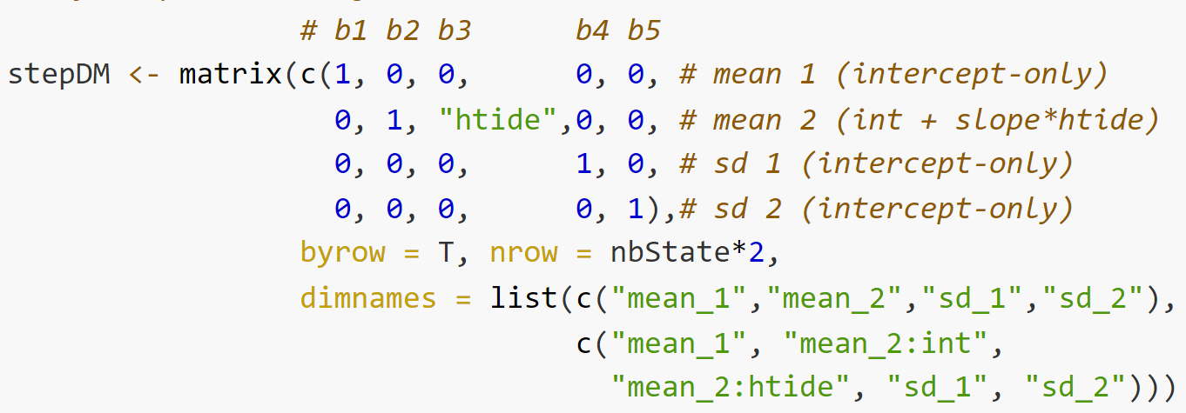
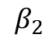
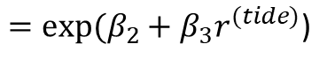
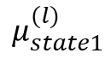
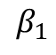
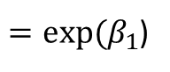
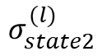
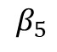
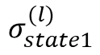
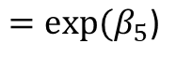
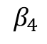
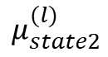
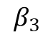
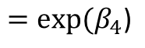
Step length pseudo-DM
$$β_{1}$$
$$β_{2}$$
$$β_{3}$$
$$β_{4}$$
$$β_{5}$$
$$μ_{state1}^{(l)}$$
$=exp⁡(β_{1}$)
$$μ_{state2}^{(l)}$$
$$=exp⁡(β_{2}+{β_{3}r}^{(tide)}\text{)}$$
$$σ_{state1}^{(l)}$$
$$=exp⁡(β_{4}\text{)}$$
$$σ_{state2}^{(l)}$$
$$=exp⁡(β_{5}\text{)}$$

Slide 14
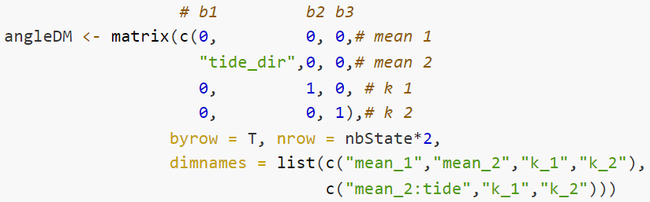
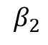
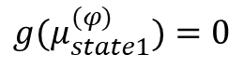
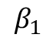
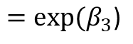
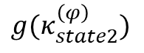
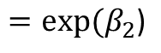
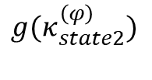
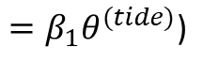
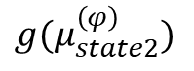
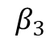
Turn angle toward tides
Turning angle ~ tide direction
Earthtide::calc_earthtide(…, method = "e_w_displacement")
Earthtide::calc_earthtide(…, method = “n_s_displacement")
tide_dir = atan2(tide_v, tide_u)
Pseudo-design matrix
$$β_{1}$$
$$β_{2}$$
$$β_{3}$$
$${g(μ}_{state1}^{(φ)})=0$$
$$g(μ_{state2}^{\left(φ\right)})$$
$$={β_{1}θ}^{(tide)}\text{)}$$
$$g(κ_{state2}^{\left(φ\right)})$$
$$=exp⁡(β_{2}\text{)}$$
$$g(κ_{state2}^{\left(φ\right)})$$
$$=exp⁡(β_{3}\text{)}$$

Slide 15
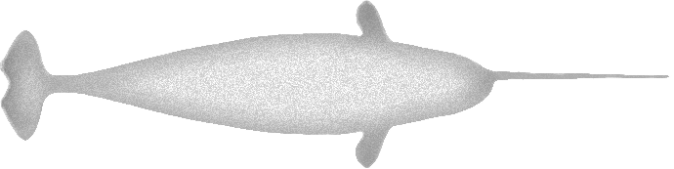
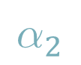

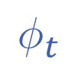
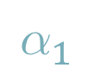
Turn angle: menotaxis relative to coastline
Turning angle ~ coastline
terra::direction(land_rast) – calculate direction to nearest coastline
Menotaxis: movement at an angle relative to stimulus
"I(land_dir + 3.14/2)" – Bias 90° left of direction to coastline
"I(land_dir - 3.14/2)" – Bias 90° right of direction to coastline
Animal track
Stimuli direction (eg. coastline)
ϑ
$$φ_{t}$$
$$α_{2}$$
Angle of attraction
$$α_{1}$$
Persistence
$$ψ$$
Bias coefficients
Persistence

Slide 16
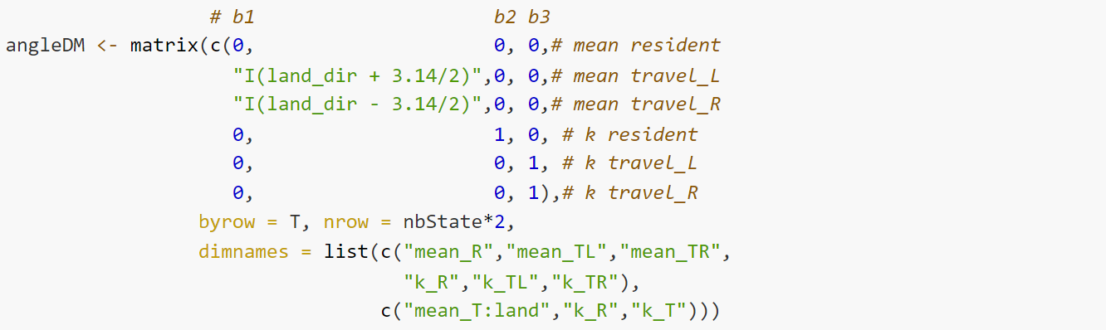
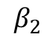
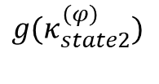
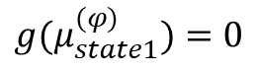
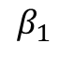
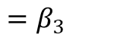
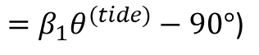
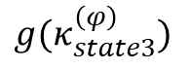
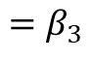
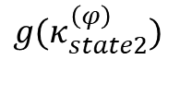





Turn angle menotactix pseudo-DM
$$β_{1}$$
$$β_{2}$$
$$β_{3}$$
$${g(μ}_{state1}^{(φ)})=0$$
$$g(μ_{state2}^{\left(φ\right)})$$
$$={β_{1}(θ}^{(tide)}+90\text{°}\text{)}$$
$$g(μ_{state3}^{\left(φ\right)})$$
$$={β_{1}θ}^{(tide)}−90\text{°}\text{)}$$
$$g(κ_{state2}^{\left(φ\right)})$$
$$=β_{2}$$
$$g(κ_{state2}^{\left(φ\right)})$$
$$=β_{3}$$
$$g(κ_{state3}^{\left(φ\right)})$$
$$=β_{3}$$

Slide 17



Behaviour transition constraints
Travelling parallel to coastline
$$Γ= \left[\begin{matrix}− & 1 & 1 \\ 3 & − & 4 \\ 3 & 4 & −\end{matrix}\right]$$
Resident

